Slide 1

Introduction to Probabilistic Machine Learning
Ralf Herbrich, Rainer Schlosser
Tutorial 2 – Recap Unit 1 & 2

Slide 2
Overview
Course Setup
Recap: Probabilities and Distributions (Unit 1)
Recap: Main Concepts of Unit 2
Example: Bayesian Inference
Example: Multiplication of Normal Distributions
Example: Decision-Making
Hints for Exercise 1 (to be handed in Monday May 5)

Slide 3
Course Overview
Week | Topic Lecture | Tutorial | Exercises
07.04. & 08.04. | 1 Probability Theory | Intro Julia
14.04. & 15.04. | 2 Inference Methods and Decision-Making | no tutorial | Exercise 1
21.04. & 22.04. | no lecture | Theory Unit 1 & 2 | (14.04. – 05.05.)
28.04. & 29.04. | 3 Graphical Models: Independence | Theory Unit 3
05.05. & 06.05. | 4 Graphical Models: Exact Inference | Theory Unit 4 | Exercise 2
12.05. & 13.05. | 5 Graphical Models: Approximate Inference | Theory Unit 5 | (05.05. – 19.05.)
19.05. & 20.05. | 6 Bayesian Ranking | Theory Unit 6 | Exercise 3
26.05. & 27.05. | 7 Linear Basis Function Models | Theory Unit 7 | (19.05. – 02.06.)
02.06. & 03.06. | 8 Bayesian Regression | Theory Unit 8 | Exercise 4
09.06. & 10.06. | no lecture | 9 Bayesian Classification | (02.06. – 23.06.)
16.06. & 11.06. | 10 Non-Bayesian Classification Learning | Theory Unit 9 & 10
23.06. & 24.06. | 11 Gaussian Processes | Theory Unit 11 | Exercise 5
30.06. & 01.07. | 12 Information Theory | Theory Unit 12 | (23.06. – 07.07.)
07.07. & 08.07. | 13 Real-World Applications

Slide 4
Overview
Course Setup
Recap: Probabilities and Distributions (Unit 1)
Recap: Main Concepts of Unit 2
Example: Bayesian Inference
Example: Multiplication of Normal Distributions
Example: Decision-Making
Hints for Exercise 1 (to be handed in Monday May 5)

Slide 5
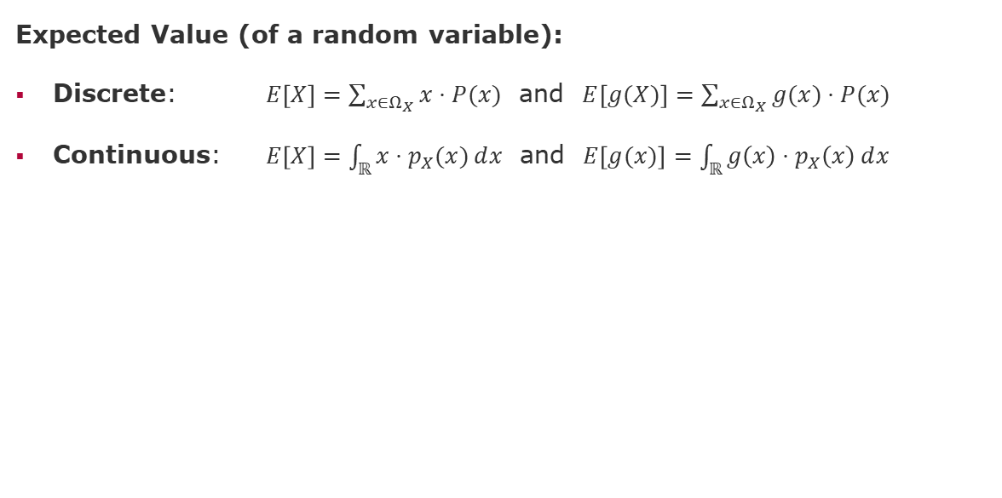
Recap: Expectation and Variance
Expected Value (of a random variable):
Discrete: $E\left[X\right]=\sum_{x∈Ω_{X}}^{ }{x⋅P(x)}$ and $E\left[g(X)\right]=\sum_{x∈Ω_{X}}^{ }{g(x)⋅P(x)}$
Continuous: $E\left[X\right]=\int_{ℝ}^{ }{x⋅p_{X}(x)ⅆx}$ and $E\left[g(x)\right]=\int_{ℝ}^{ }{g\left(x\right)⋅p_{X}\left(x\right)ⅆx}$

Slide 6
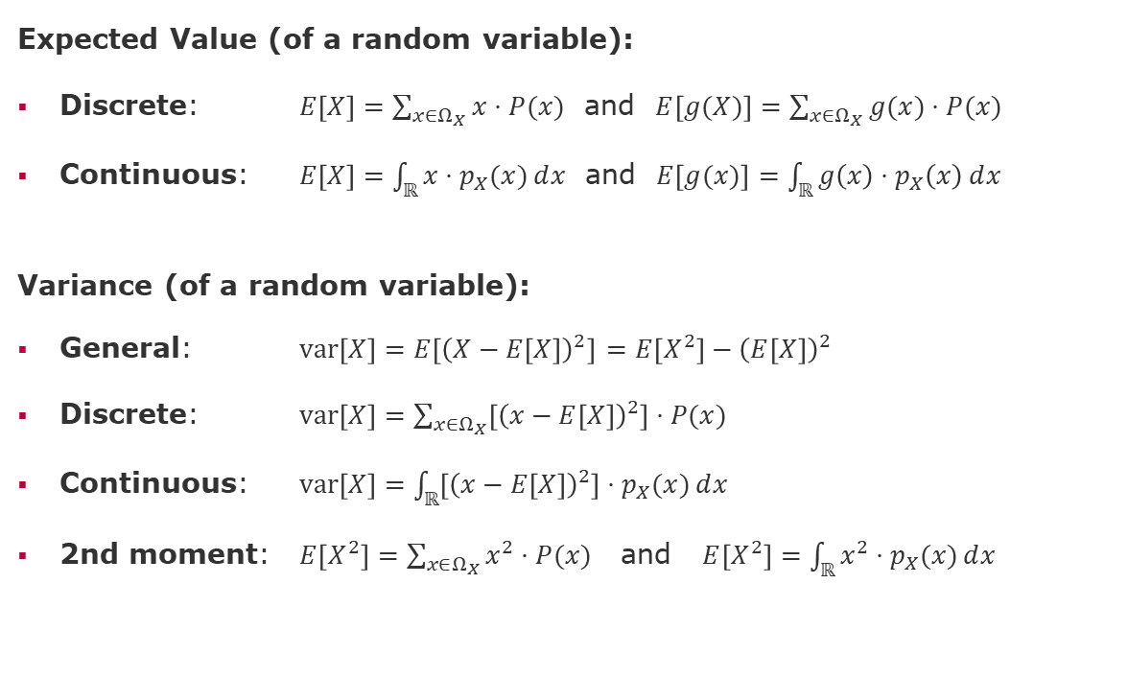
Recap: Expectation and Variance
Expected Value (of a random variable):
Discrete: $E\left[X\right]=\sum_{x∈Ω_{X}}^{ }{x⋅P(x)}$ and $E\left[g(X)\right]=\sum_{x∈Ω_{X}}^{ }{g(x)⋅P(x)}$
Continuous: $E\left[X\right]=\int_{ℝ}^{ }{x⋅p_{X}(x)ⅆx}$ and $E\left[g(x)\right]=\int_{ℝ}^{ }{g\left(x\right)⋅p_{X}\left(x\right)ⅆx}$
Variance (of a random variable):
General: $var\left[X\right]=E\left[{\left(X−E\left[X\right]\right)}^{2}\right]$ $=E\left[X^{2}\right]−{\left(E\left[X\right]\right)}^{2}$
Discrete: $var\left[X\right]=\sum_{x∈Ω_{X}}^{ }{\left[{\left(x−E\left[X\right]\right)}^{2}\right]⋅P(x)}$
Continuous: $var\left[X\right]=\int_{ℝ}^{ }{\left[{\left(x−E\left[X\right]\right)}^{2}\right]⋅p_{X}(x)ⅆx}$
2nd moment: $E\left[X^{2}\right]=\sum_{x∈Ω_{X}}^{ }{x^{2}⋅P(x)}$ and $E\left[X^{2}\right]=\int_{ℝ}^{ }{x^{2}⋅p_{X}(x)ⅆx}$

Slide 7
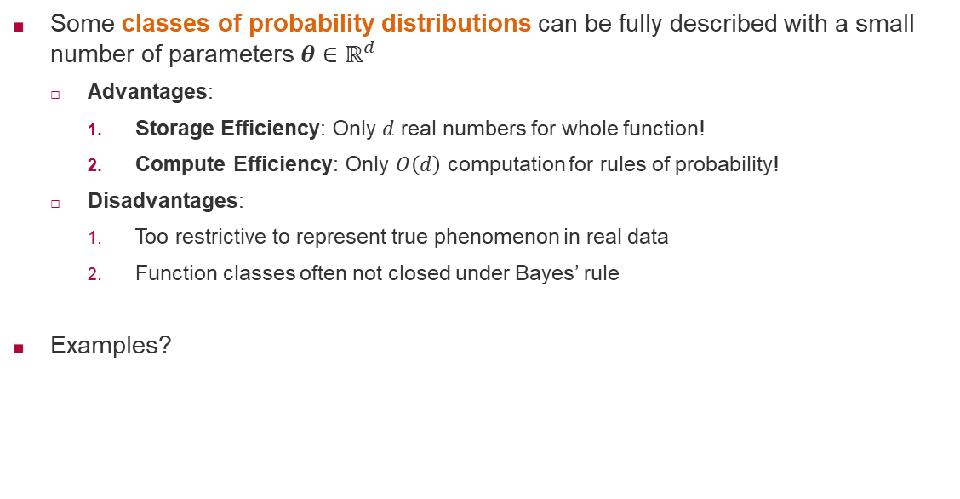
Recap: Classes of Probability Distributions
Some classes of probability distributions can be fully described with a small number of parameters $θ∈ℝ^{d}$
Advantages:
Storage Efficiency: Only $d$ real numbers for whole function!
Compute Efficiency: Only $O\left(d\right)$ computation for rules of probability!
Disadvantages:
Too restrictive to represent true phenomenon in real data
Function classes often not closed under Bayes’ rule
Examples?

Slide 8
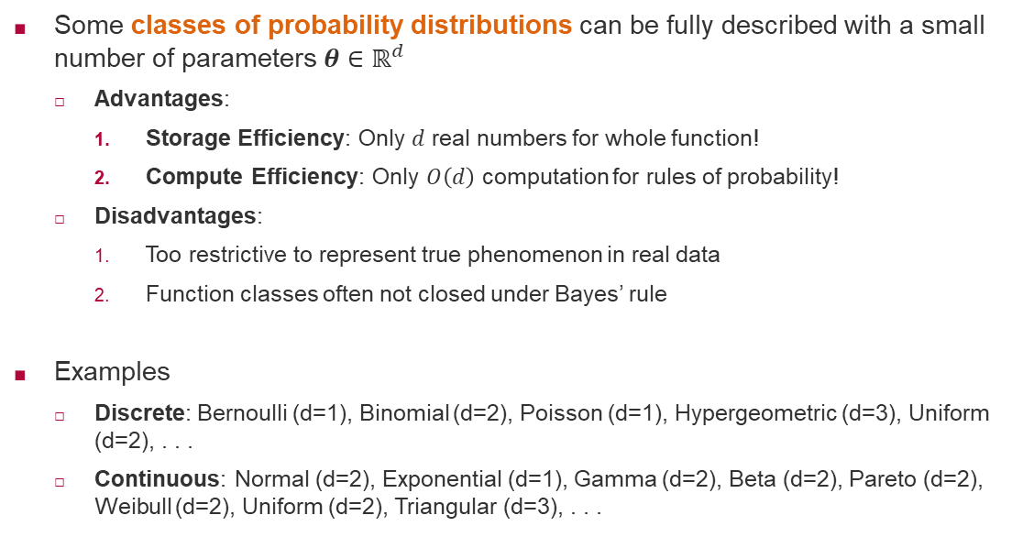
Recap: Classes of Probability Distributions
Some classes of probability distributions can be fully described with a small number of parameters $θ∈ℝ^{d}$
Advantages:
Storage Efficiency: Only $d$ real numbers for whole function!
Compute Efficiency: Only $O\left(d\right)$ computation for rules of probability!
Disadvantages:
Too restrictive to represent true phenomenon in real data
Function classes often not closed under Bayes’ rule
Examples
Discrete: Bernoulli (d=1), Binomial (d=2), Poisson (d=1), Hypergeometric (d=3), Uniform (d=2), . . .
Continuous: Normal (d=2), Exponential (d=1), Gamma (d=2), Beta (d=2), Pareto (d=2), Weibull (d=2), Uniform (d=2), Triangular (d=3), . . .

Slide 9
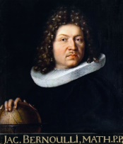
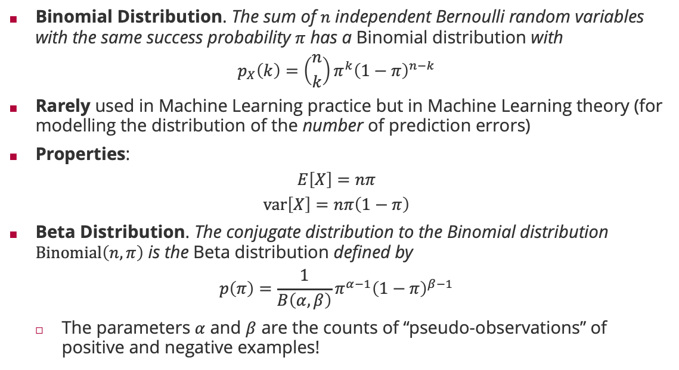
Recap: Probability Distributions: Binomial & Beta Distribution
Binomial Distribution. The sum of $n$ independent Bernoulli random variables with the same success probability $π$ has a Binomial distribution with
$$p_{X}\left(k\right)=\left({n \atop k}\right)π^{k}{\left(1−π\right)}^{n−k}$$
Rarely used in Machine Learning practice but in Machine Learning theory (for modelling the distribution of the number of prediction errors)
Properties:
$$E\left[X\right]=nπ$$
$$var\left[X\right]=nπ\left(1−π\right)$$
Beta Distribution. The conjugate distribution to the Binomial distribution $Binomial\left(n,π\right)$ is the Beta distribution defined by
$$p\left(π\right)=\frac{1}{B\left(α,β\right)}π^{α−1}{\left(1−π\right)}^{β−1}$$
The parameters $α$ and $β$ are the counts of “pseudo-observations” of positive and negative examples!
Jacob Bernoulli (1655 – 1705)

Slide 10
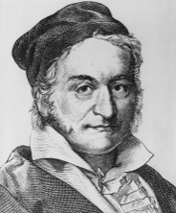
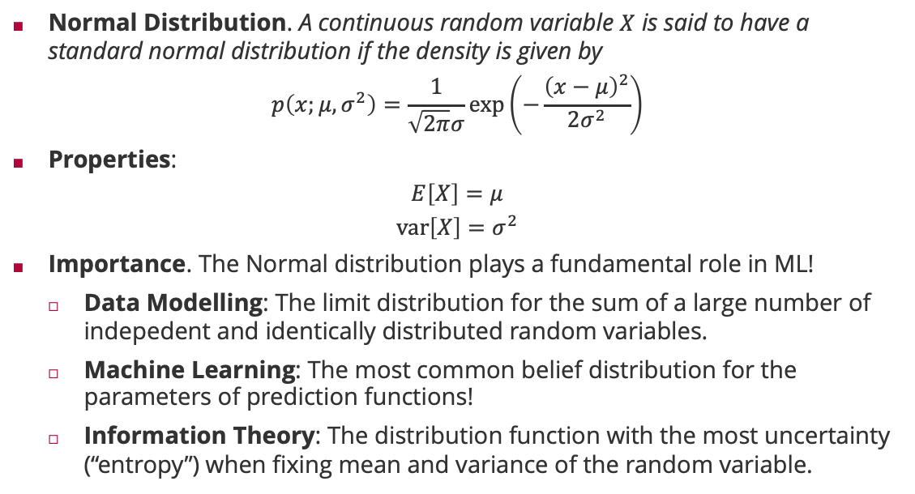
Recap: Probability Distributions: Normal
Normal Distribution. A continuous random variable $X$ is said to have a standard normal distribution if the density is given by
$$p\left(x;μ,σ^{2}\right)=\frac{1}{\sqrt{2π}σ}\exp\left(−\frac{{\left(x−μ\right)}^{2}}{2σ^{2}}\right)$$
Properties:
$$E\left[X\right]=μ$$
$$var\left[X\right]=σ^{2}$$
Importance. The Normal distribution plays a fundamental role in ML!
Data Modelling: The limit distribution for the sum of a large number of indepedent and identically distributed random variables.
Machine Learning: The most common belief distribution for the parameters of prediction functions!
Information Theory: The distribution function with the most uncertainty (“entropy”) when fixing mean and variance of the random variable.
Carl Friedrich Gauss (1777 - 1855)

Slide 11
Overview
Course Setup
Recap: Probabilities and Distributions (Unit 1)
Recap: Main Concepts of Unit 2
Example: Bayesian Inference
Example: Multiplication of Normal Distributions
Example: Decision-Making
Hints for Exercise 1 (to be handed in Monday May 5)

Slide 12
Recap Unit 2: Overview of Concepts
Data Regression Prediction Classification
Functions/Models Characterizations by Parameters Beliefs Confidence
Bayesian Inference Bayes Rule Prior Likelihood Posterior
Conjugacy Distribution Classes Sigmoid Normal CDF
Representations of Gaussian Densities Multiplication of Densities
Maximum Likelihood Maximum A Posterior Estimation Point Estimates
Loss Function Decision Making Actions Expected Loss
Optimization Gradient Decent Deep Learning Updates
Reinforcement Learning

Slide 13
Recap Unit 2: Overview of Concepts and Focus
Data Regression Prediction Classification
Functions/Models Characterizations by Parameters Beliefs Confidence
Bayesian Inference Bayes Rule Prior Likelihood Posterior
Conjugacy Distribution Classes Sigmoid Normal CDF
Representations of Gaussian Densities Multiplication of Densities
Maximum Likelihood Maximum A Posterior Estimation Point Estimates
Loss Function Decision Making Actions Expected Loss
Optimization Gradient Decent Deep Learning Updates
Reinforcement Learning

Slide 14
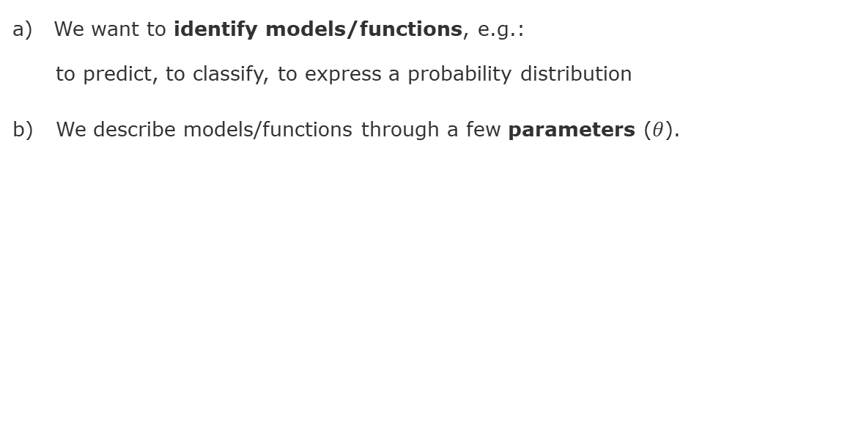
Bayesian Inference in a Nutshell
We want to identify models/functions, e.g.:
to predict, to classify, to express a probability distribution
b) We describe models/functions through a few parameters ($θ$).

Slide 15
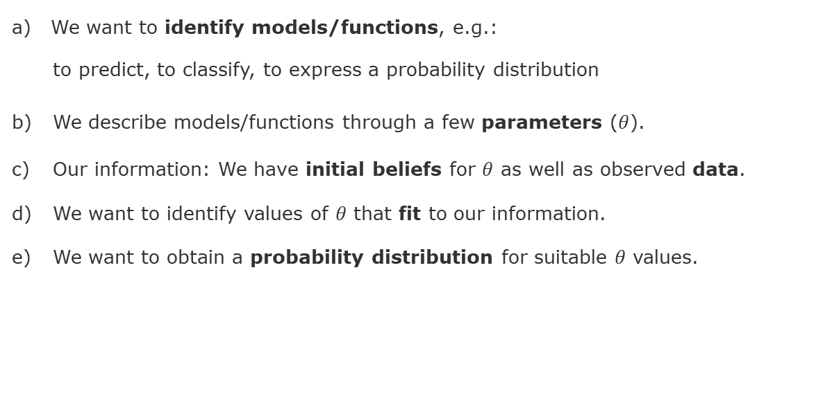
Bayesian Inference in a Nutshell
We want to identify models/functions, e.g.:
to predict, to classify, to express a probability distribution
b) We describe models/functions through a few parameters ($θ$).
c) Our information: We have initial beliefs for $θ$ as well as observed data.
d) We want to identify values of $θ$ that fit to our information.
e) We want to obtain a probability distribution for suitable $θ$ values.

Slide 16
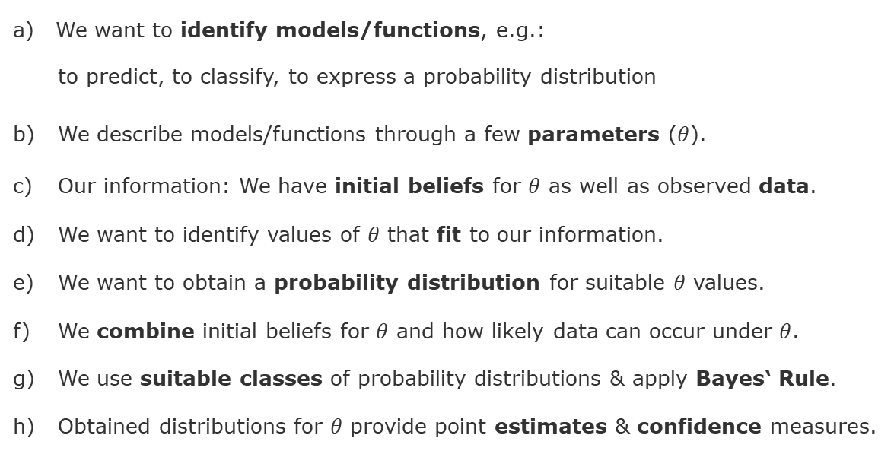
Bayesian Inference in a Nutshell
We want to identify models/functions, e.g.:
to predict, to classify, to express a probability distribution
b) We describe models/functions through a few parameters ($θ$).
c) Our information: We have initial beliefs for $θ$ as well as observed data.
d) We want to identify values of $θ$ that fit to our information.
e) We want to obtain a probability distribution for suitable $θ$ values.
f) We combine initial beliefs for $θ$ and how likely data can occur under $θ$.
g) We use suitable classes of probability distributions & apply Bayes‘ Rule.
h) Obtained distributions for $θ$ provide point estimates & confidence measures.

Slide 17
Overview
Course Setup
Recap: Probabilities and Distributions (Unit 1)
Recap: Main Concepts of Unit 2
Example: Bayesian Inference
Example: Multiplication of Normal Distributions
Example: Decision-Making
Hints for Exercise 1 (to be handed in Monday May 5)

Slide 18
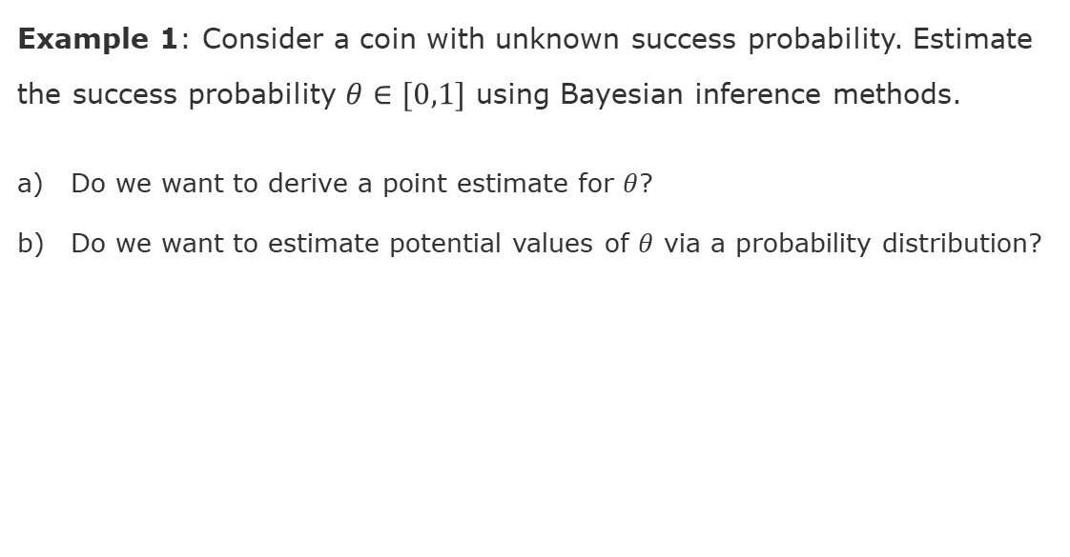
Application: Coin Toss - How do we start?
Example 1: Consider a coin with unknown success probability. Estimate the success probability $θ∈[0,1]$ using Bayesian inference methods.
Do we want to derive a point estimate for $θ$?
Do we want to estimate potential values of $θ$ via a probability distribution?

Slide 19
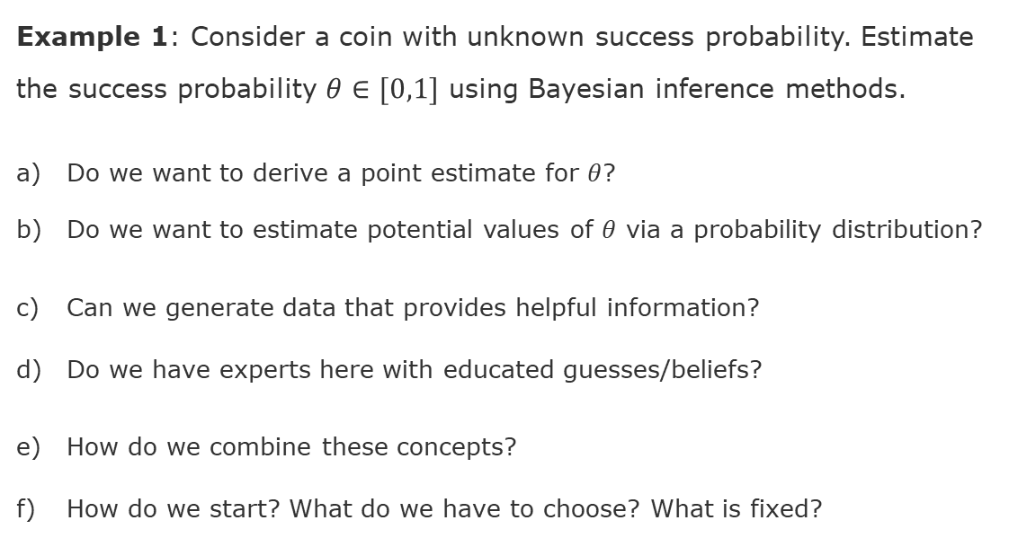
Application: Coin Toss - How do we start?
Example 1: Consider a coin with unknown success probability. Estimate the success probability $θ∈[0,1]$ using Bayesian inference methods.
Do we want to derive a point estimate for $θ$?
Do we want to estimate potential values of $θ$ via a probability distribution?
Can we generate data that provides helpful information?
Do we have experts here with educated guesses/beliefs?
How do we combine these concepts?
How do we start? What do we have to choose? What is fixed?

Slide 20
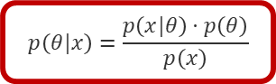
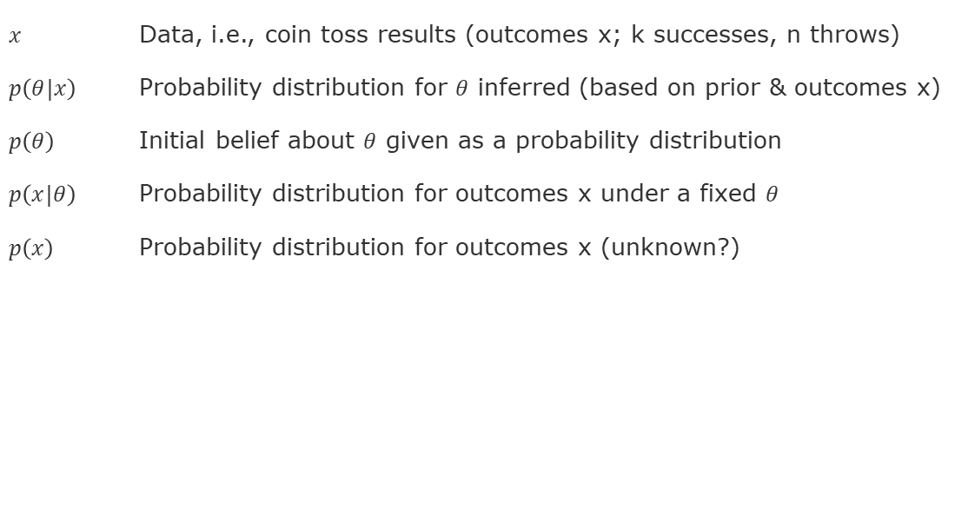
We shall use Bayes‘ Rule
$x$ Data, i.e., coin toss results (outcomes x; k successes, n throws)
$p\left(θ|x\right)$ Probability distribution for $θ$ inferred (based on prior & outcomes x)
$p\left(θ\right)$ Initial belief about $θ$ given as a probability distribution
$p\left(x|θ\right)$ Probability distribution for outcomes x under a fixed $θ$
$p\left(x\right)$ Probability distribution for outcomes x (unknown?)
Bayes’ Rule for Random Variables
$$p\left(θ|x\right)=\frac{p\left(x|θ\right)⋅p\left(θ\right)}{p\left(x\right)}$$

Slide 21
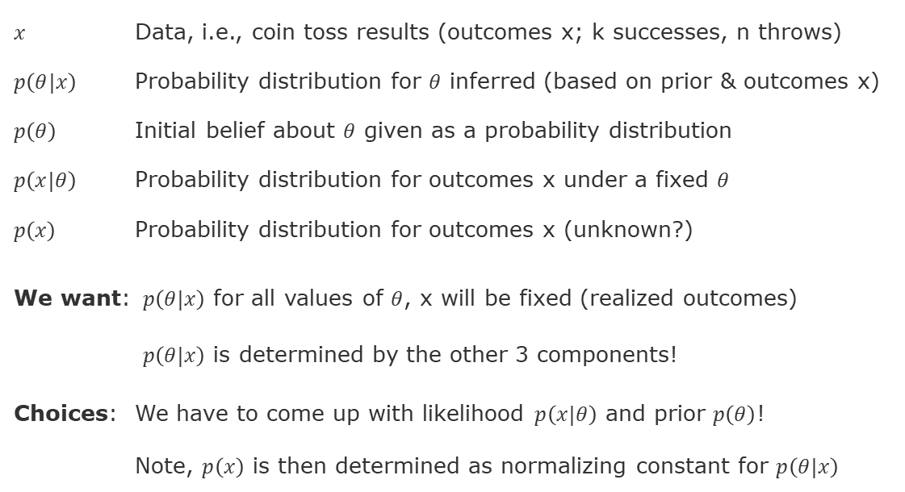
We shall use Bayes‘ Rule
$x$ Data, i.e., coin toss results (outcomes x; k successes, n throws)
$p\left(θ|x\right)$ Probability distribution for $θ$ inferred (based on prior & outcomes x)
$p\left(θ\right)$ Initial belief about $θ$ given as a probability distribution
$p\left(x|θ\right)$ Probability distribution for outcomes x under a fixed $θ$
$p\left(x\right)$ Probability distribution for outcomes x (unknown?)
We want: $p\left(θ|x\right)$ for all values of $θ$, x will be fixed (realized outcomes)
$p\left(θ|x\right)$ is determined by the other 3 components!
Choices: We have to come up with likelihood $p\left(x|θ\right)$ and prior $p\left(θ\right)$!
Note, $p\left(x\right)$ is then determined as normalizing constant for $p\left(θ|x\right)$
Bayes’ Rule for Random Variables
$$p\left(θ|x\right)=\frac{p\left(x|θ\right)⋅p\left(θ\right)}{p\left(x\right)}$$

Slide 22
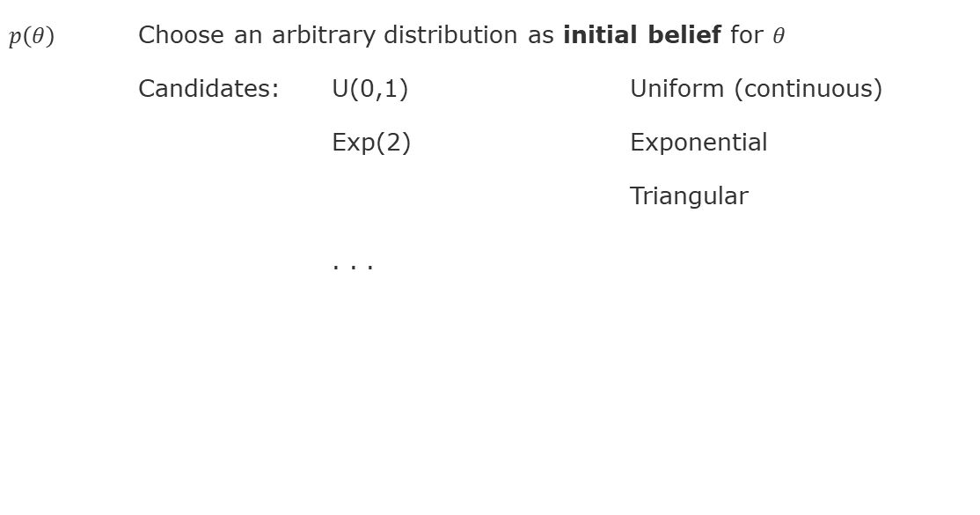
Remaining Choices: Prior & Likelihood
$p\left(θ\right)$ Choose an arbitrary distribution as initial belief for $θ$
Candidates: U(0,1) Uniform (continuous)
Exp(2) Exponential
Triangular
. . .
Bayes’ Rule for Random Variables
$$p\left(θ|x\right)=\frac{p\left(x|θ\right)⋅p\left(θ\right)}{p\left(x\right)}$$

Slide 23
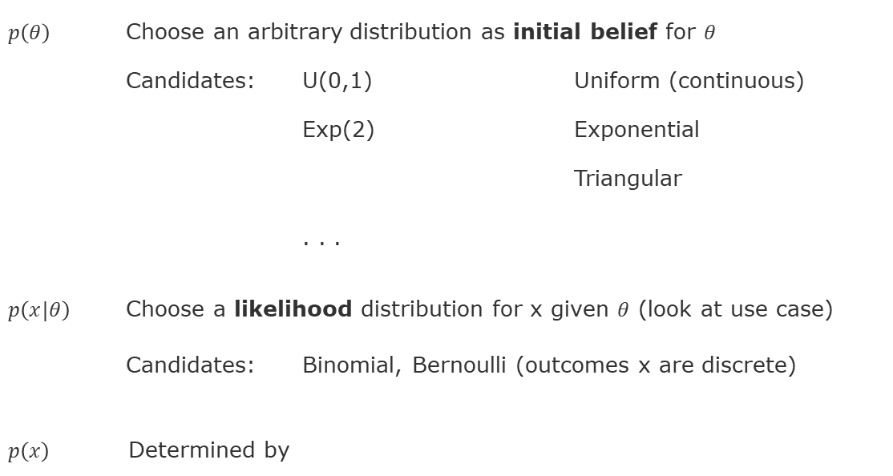
Remaining Choices: Prior & Likelihood
$p\left(θ\right)$ Choose an arbitrary distribution as initial belief for $θ$
Candidates: U(0,1) Uniform (continuous)
Exp(2) Exponential
Triangular
. . .
$p\left(x|θ\right)$ Choose a likelihood distribution for x given $θ$ (look at use case)
Candidates: Binomial, Bernoulli (outcomes x are discrete)
$p\left(x\right)$ Determined by
Bayes’ Rule for Random Variables
$$p\left(θ|x\right)=\frac{p\left(x|θ\right)⋅p\left(θ\right)}{p\left(x\right)}$$

Slide 24
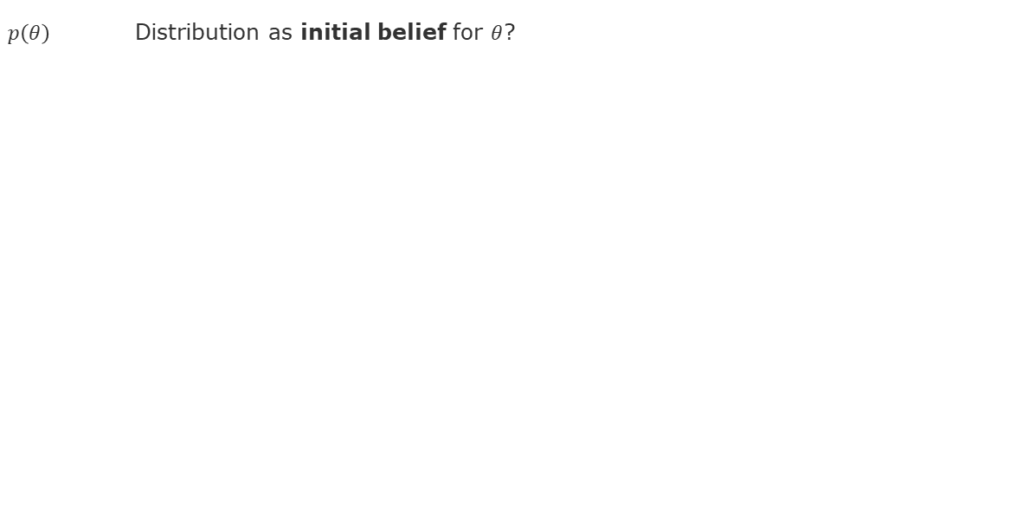
How to Determine the Remaining Choices?
$p\left(θ\right)$ Distribution as initial belief for $θ$?
Bayes’ Rule for Random Variables
$$p\left(θ|x\right)=\frac{p\left(x|θ\right)⋅p\left(θ\right)}{p\left(x\right)}$$

Slide 25
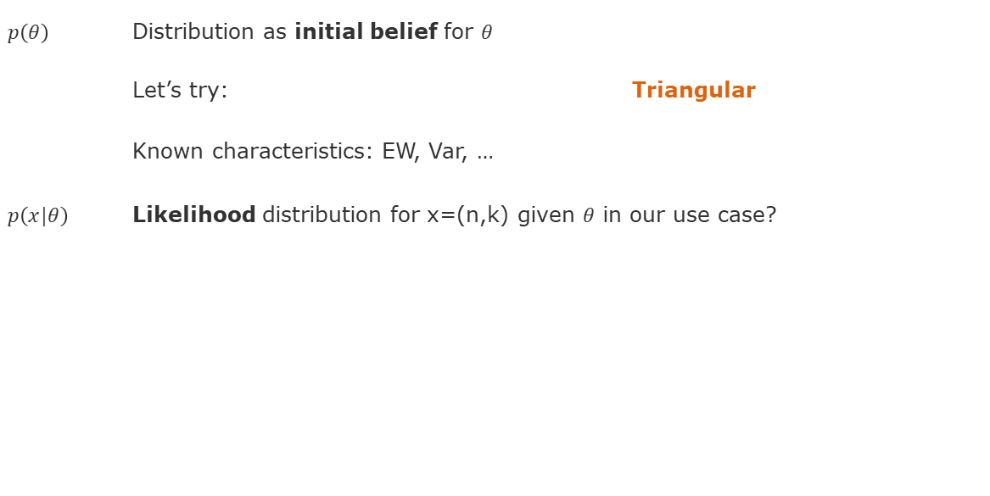
How to Determine the Remaining Choices?
$p\left(θ\right)$ Distribution as initial belief for $θ$
Let’s try: Triangular
Known characteristics: EW, Var, …
$p\left(x|θ\right)$ Likelihood distribution for x=(n,k) given $θ$ in our use case?
Bayes’ Rule for Random Variables
$$p\left(θ|x\right)=\frac{p\left(x|θ\right)⋅p\left(θ\right)}{p\left(x\right)}$$

Slide 26
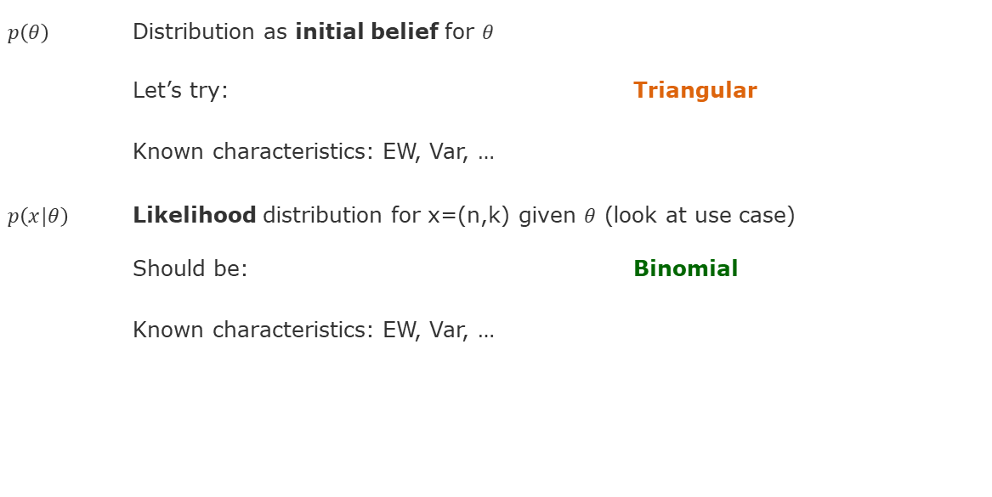
How to Determine the Remaining Choices?
$p\left(θ\right)$ Distribution as initial belief for $θ$
Let’s try: Triangular
Known characteristics: EW, Var, …
$p\left(x|θ\right)$ Likelihood distribution for x=(n,k) given $θ$ (look at use case)
Should be: Binomial
Known characteristics: EW, Var, …
Bayes’ Rule for Random Variables
$$p\left(θ|x\right)=\frac{p\left(x|θ\right)⋅p\left(θ\right)}{p\left(x\right)}$$

Slide 27
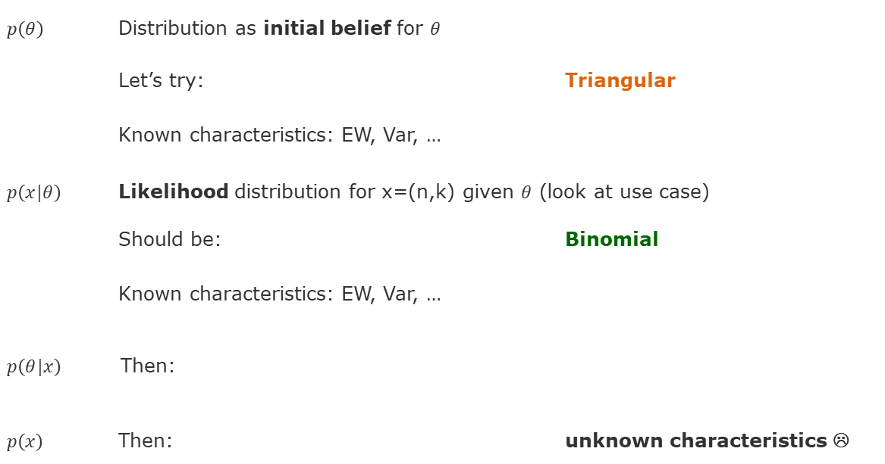
How to Determine the Remaining Choices?
$p\left(θ\right)$ Distribution as initial belief for $θ$
Let’s try: Triangular
Known characteristics: EW, Var, …
$p\left(x|θ\right)$ Likelihood distribution for x=(n,k) given $θ$ (look at use case)
Should be: Binomial
Known characteristics: EW, Var, …
$p\left(θ|x\right)$ Then:
$p\left(x\right)$ Then: unknown characteristics ☹
Bayes’ Rule for Random Variables
$$p\left(θ|x\right)=\frac{p\left(x|θ\right)⋅p\left(θ\right)}{p\left(x\right)}$$

Slide 28
Let‘s try Beta Distributions!

Slide 29
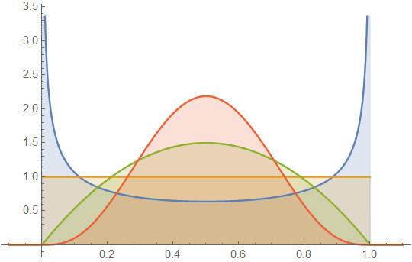
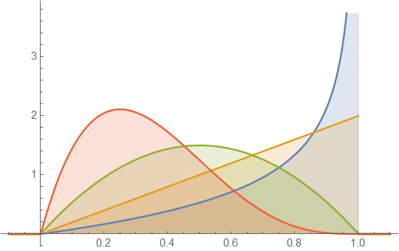
Let‘s try Beta Distributions!

Slide 30
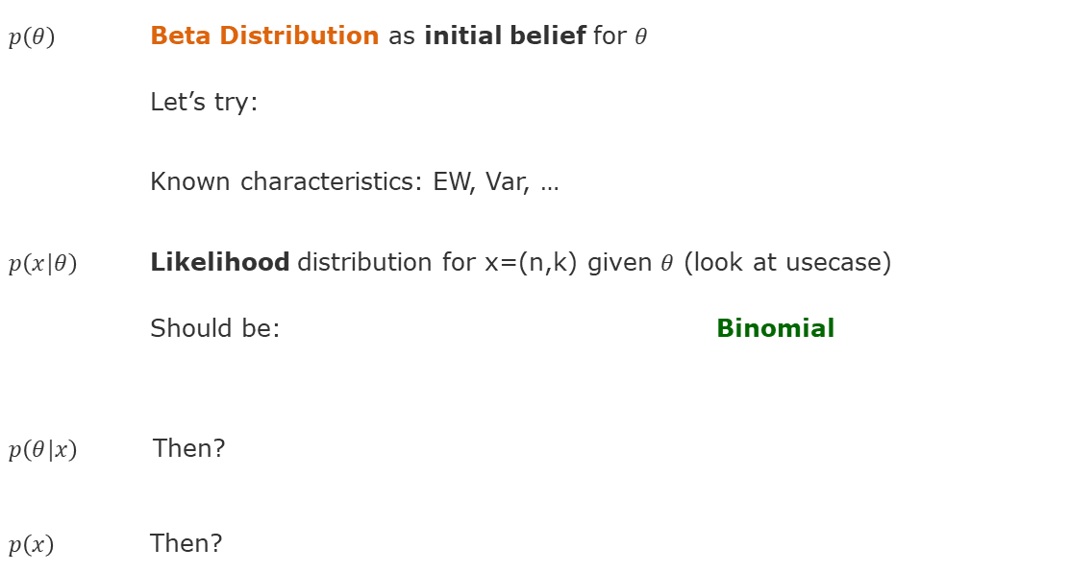
Let‘s try Beta Distributions!
$p\left(θ\right)$ Beta Distribution as initial belief for $θ$
Let’s try:
Known characteristics: EW, Var, …
$p\left(x|θ\right)$ Likelihood distribution for x=(n,k) given $θ$ (look at usecase)
Should be: Binomial
$p\left(θ|x\right)$ Then?
$p\left(x\right)$ Then?
Bayes’ Rule for Random Variables
$$p\left(θ|x\right)=\frac{p\left(x|θ\right)⋅p\left(θ\right)}{p\left(x\right)}$$

Slide 31
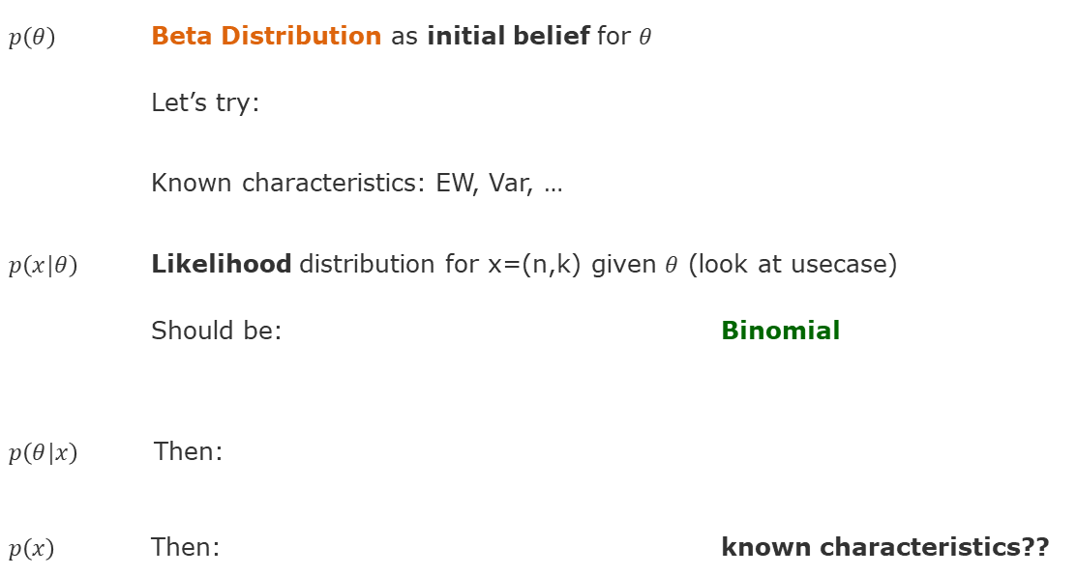
Let‘s try Beta Distributions!
$p\left(θ\right)$ Beta Distribution as initial belief for $θ$
Let’s try:
Known characteristics: EW, Var, …
$p\left(x|θ\right)$ Likelihood distribution for x=(n,k) given $θ$ (look at usecase)
Should be: Binomial
$p\left(θ|x\right)$ Then:
$p\left(x\right)$ Then: known characteristics??
Bayes’ Rule for Random Variables
$$p\left(θ|x\right)=\frac{p\left(x|θ\right)⋅p\left(θ\right)}{p\left(x\right)}$$

Slide 32
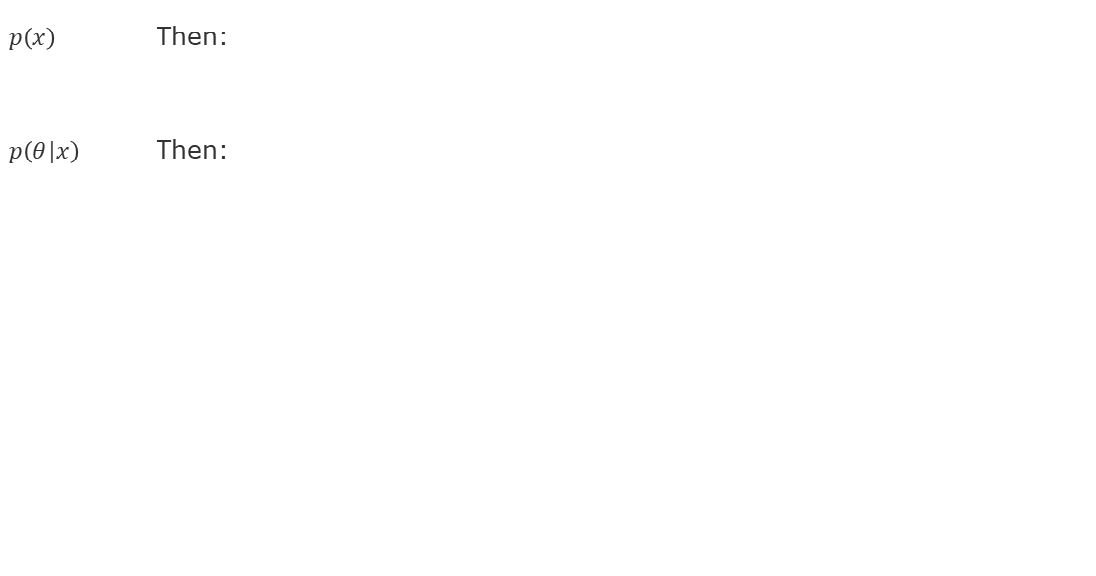
Beta Distributions x Binomial Distribution = ??
$p\left(x\right)$ Then:
$p\left(θ|x\right)$ Then:
Bayes’ Rule for Random Variables
$$p\left(θ|x\right)=\frac{p\left(x|θ\right)⋅p\left(θ\right)}{p\left(x\right)}$$

Slide 33
Beta Distributions x Binomial Distribution = ??
$p\left(x\right)$ Then:
$p\left(θ|x\right)$ Then:
Bayes’ Rule for Random Variables
$$p\left(θ|x\right)=\frac{p\left(x|θ\right)⋅p\left(θ\right)}{p\left(x\right)}$$

Slide 34
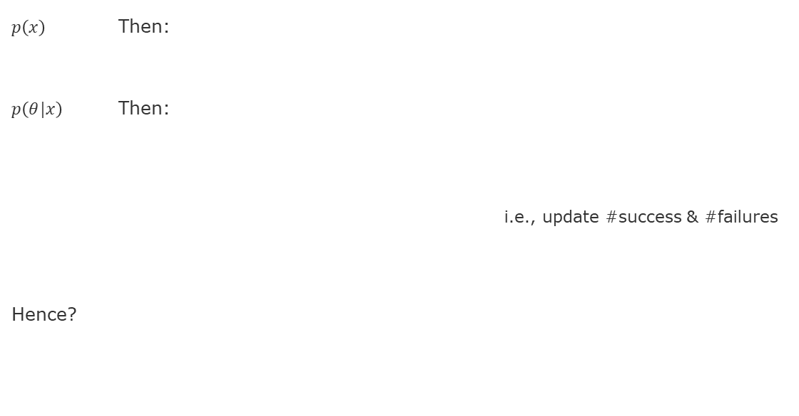
Beta Distributions x Binomial Distribution = ??
$p\left(x\right)$ Then:
$p\left(θ|x\right)$ Then:
i.e., update #success & #failures
Hence?
Bayes’ Rule for Random Variables
$$p\left(θ|x\right)=\frac{p\left(x|θ\right)⋅p\left(θ\right)}{p\left(x\right)}$$

Slide 35
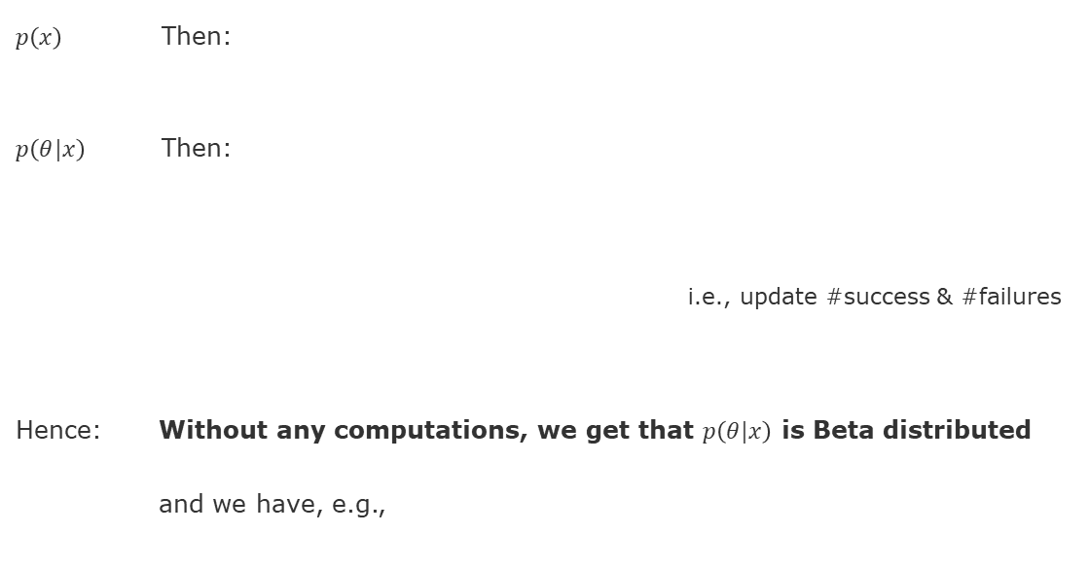
Beta Distributions x Binomial Distribution = ??
$p\left(x\right)$ Then:
$p\left(θ|x\right)$ Then:
i.e., update #success & #failures
Hence: Without any computations, we get that $p\left(θ|x\right)$ is Beta distributed
and we have, e.g.,
Bayes’ Rule for Random Variables
$$p\left(θ|x\right)=\frac{p\left(x|θ\right)⋅p\left(θ\right)}{p\left(x\right)}$$

Slide 36
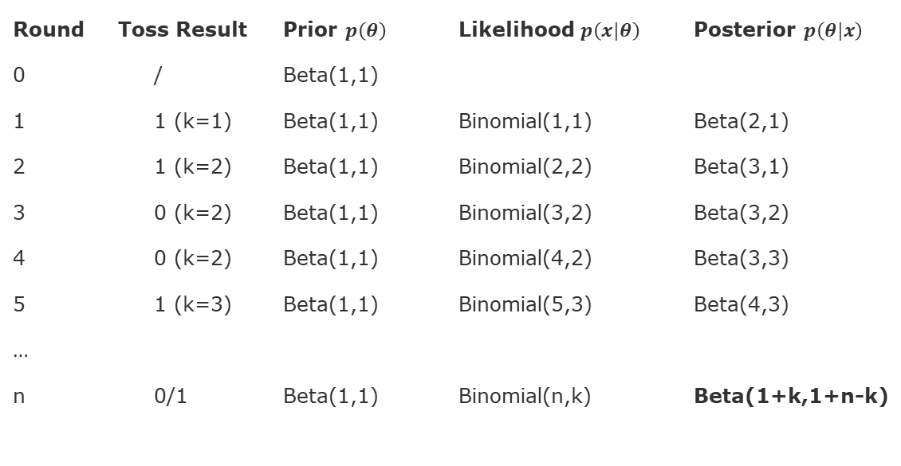
Back to the Coin Toss Example (1 Binomial Update)
Round Toss Result Prior $p\left(θ\right)$ Likelihood $p\left(x|θ\right)$ Posterior $p\left(θ|x\right)$
0 / Beta(1,1)
1 1 (k=1) Beta(1,1) Binomial(1,1) Beta(2,1)
2 1 (k=2) Beta(1,1) Binomial(2,2) Beta(3,1)
3 0 (k=2) Beta(1,1) Binomial(3,2) Beta(3,2)
4 0 (k=2) Beta(1,1) Binomial(4,2) Beta(3,3)
5 1 (k=3) Beta(1,1) Binomial(5,3) Beta(4,3)
…
n 0/1 Beta(1,1) Binomial(n,k) Beta(1+k,1+n-k)
Bayes’ Rule for Random Variables
$$p\left(θ|x\right)=\frac{p\left(x|θ\right)⋅p\left(θ\right)}{p\left(x\right)}$$

Slide 37
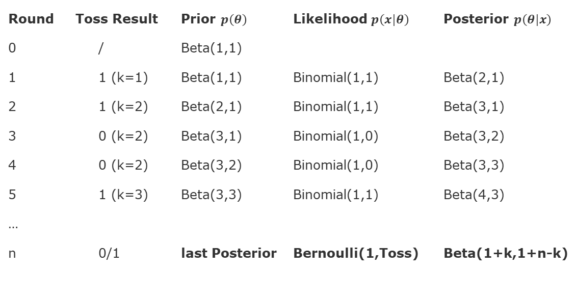
Back to the Coin Toss Example (n Bernoulli Updates)
Round Toss Result Prior $p\left(θ\right)$ Likelihood $p\left(x|θ\right)$ Posterior $p\left(θ|x\right)$
0 / Beta(1,1)
1 1 (k=1) Beta(1,1) Binomial(1,1) Beta(2,1)
2 1 (k=2) Beta(2,1) Binomial(1,1) Beta(3,1)
3 0 (k=2) Beta(3,1) Binomial(1,0) Beta(3,2)
4 0 (k=2) Beta(3,2) Binomial(1,0) Beta(3,3)
5 1 (k=3) Beta(3,3) Binomial(1,1) Beta(4,3)
…
n 0/1 last Posterior Bernoulli(1,Toss) Beta(1+k,1+n-k)
Bayes’ Rule for Random Variables
$$p\left(θ|x\right)=\frac{p\left(x|θ\right)⋅p\left(θ\right)}{p\left(x\right)}$$

Slide 38
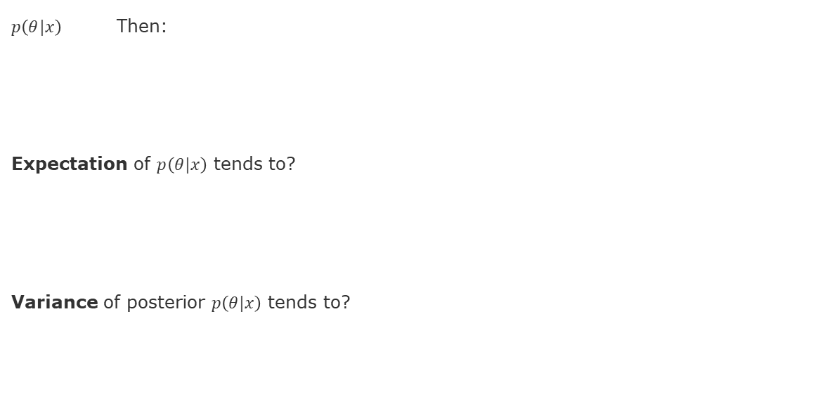
Coin Toss Example: Asymptotics
$p\left(θ|x\right)$ Then:
Expectation of $p\left(θ|x\right)$ tends to?
Variance of posterior $p\left(θ|x\right)$ tends to?
Bayes’ Rule for Random Variables
$$p\left(θ|x\right)=\frac{p\left(x|θ\right)⋅p\left(θ\right)}{p\left(x\right)}$$

Slide 39
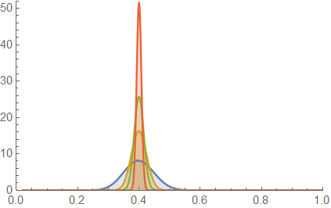
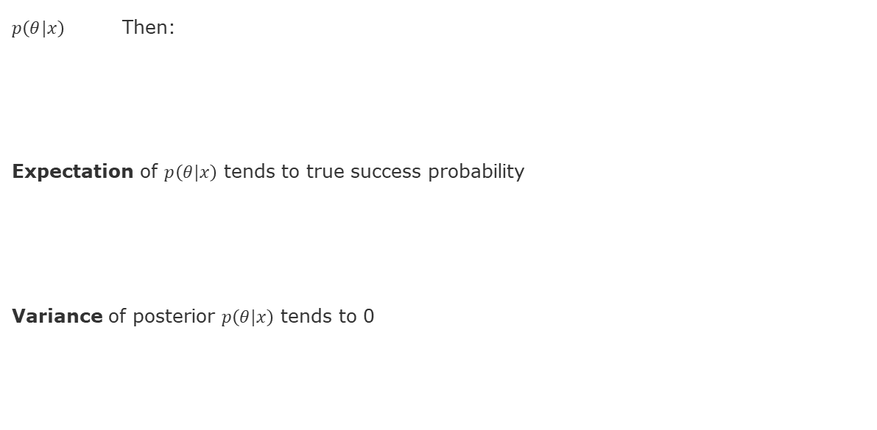
Coin Toss Example: Asymptotics
$p\left(θ|x\right)$ Then:
Expectation of $p\left(θ|x\right)$ tends to true success probability
Variance of posterior $p\left(θ|x\right)$ tends to 0
Bayes’ Rule for Random Variables
$$p\left(θ|x\right)=\frac{p\left(x|θ\right)⋅p\left(θ\right)}{p\left(x\right)}$$

Slide 40
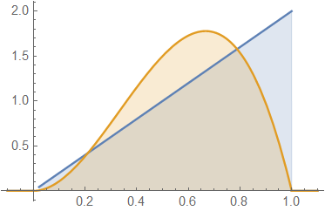
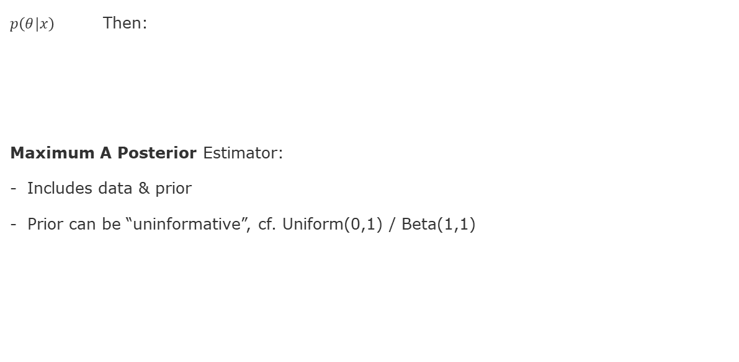
Point Estimates of the Success Probability
$p\left(θ|x\right)$ Then:
Maximum A Posterior Estimator:
Includes data & prior
Prior can be “uninformative”, cf. Uniform(0,1) / Beta(1,1)
Bayes’ Rule for Random Variables
$$p\left(θ|x\right)=\frac{p\left(x|θ\right)⋅p\left(θ\right)}{p\left(x\right)}$$

Slide 41
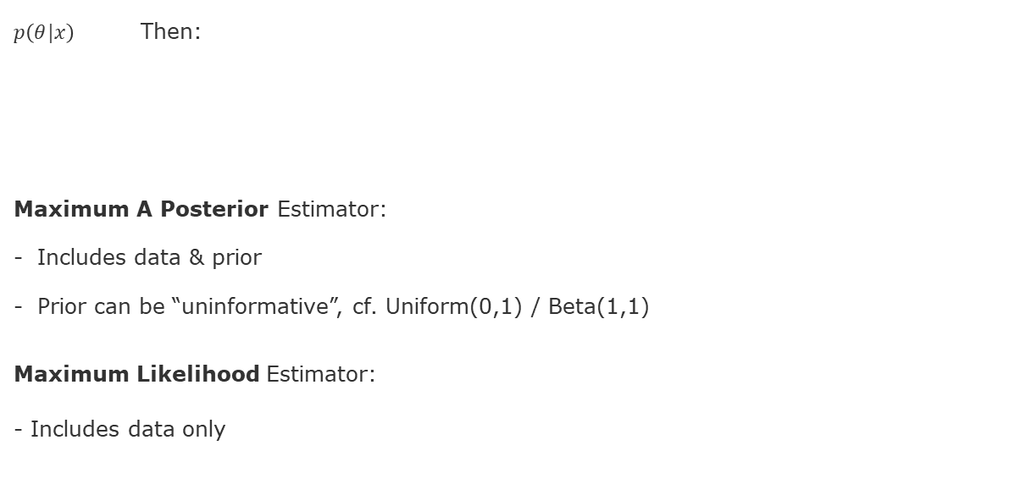
Point Estimates of the Success Probability
$p\left(θ|x\right)$ Then:
Maximum A Posterior Estimator:
Includes data & prior
Prior can be “uninformative”, cf. Uniform(0,1) / Beta(1,1)
Maximum Likelihood Estimator:
- Includes data only
Bayes’ Rule for Random Variables
$$p\left(θ|x\right)=\frac{p\left(x|θ\right)⋅p\left(θ\right)}{p\left(x\right)}$$

Slide 42
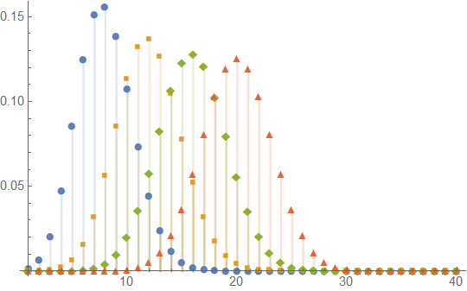
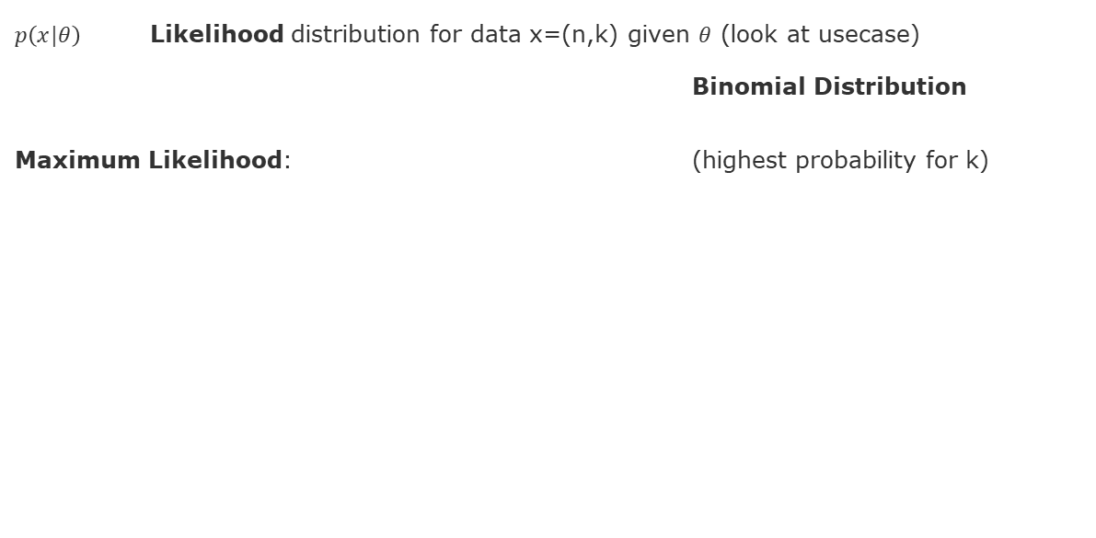
Recap: Maximum Likelihood Estimator
$p\left(x|θ\right)$ Likelihood distribution for data x=(n,k) given $θ$ (look at usecase)
Binomial Distribution
Maximum Likelihood: (highest probability for k)
Bayes’ Rule for Random Variables
$$p\left(θ|x\right)=\frac{p\left(x|θ\right)⋅p\left(θ\right)}{p\left(x\right)}$$

Slide 43
Overview
Course Setup
Recap: Probabilities and Distributions (Unit 1)
Recap: Main Concepts of Unit 2
Example: Bayesian Inference
Example: Multiplication of Normal Distributions
Example: Decision-Making
Hints for Exercise 1 (to be handed in Monday May 5)

Slide 44

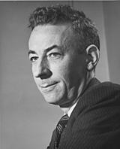
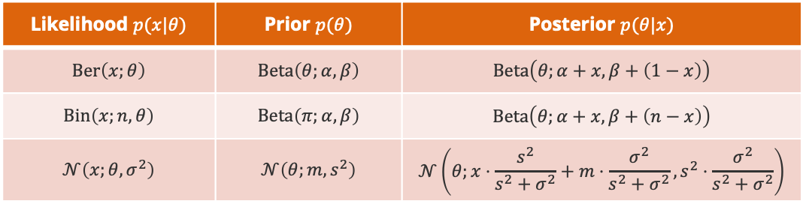
Recap: Probability Distributions: Conjugacy
Bayes Rule for Random Variables. For any probability distribution $p$ over two random variables $X$ and $Θ$, it holds
$$p\left(θ|x\right)=\frac{p\left(x|θ\right)⋅p\left(θ\right)}{p\left(x\right)}$$
Conjugacy. A family ${\left\{p\left(x,θ\right)\right\}}_{x,θ}$ is conjugate if the posterior $p\left(θ|x\right)$ is part of the same family as the prior $p\left(θ\right)$ for any value of $x$.
Big Advantage: Computing the exact posterior is computationally efficient!
Likelihood
$$p\left(x,θ\right)$$
Howard Raiffa (1924 – 2016)
Posterior
Prior
Likelihood $p(x|θ)$ | Prior $p(θ)$ | Posterior $p(θ|x)$
$$Ber\left(x;θ\right)$$ | $$Beta\left(θ;α,β\right)$$ | $$Beta\left(θ;α+x,β+\left(1−x\right)\right)$$
$$Bin\left(x;n,θ\right)$$ | $$Beta\left(π;α,β\right)$$ | $$Beta\left(θ;α+x,β+\left(n−x\right)\right)$$
$$𝒩\left(x;θ,σ^{2}\right)$$ | $$𝒩\left(θ;m,s^{2}\right)$$ | $$𝒩\left(θ;x⋅\frac{s^{2}}{s^{2}+σ^{2}}+m⋅\frac{σ^{2}}{s^{2}+σ^{2}},s^{2}⋅\frac{σ^{2}}{s^{2}+σ^{2}}\right)$$
Robert Osher Schlaifer (1914 – 1994)

Slide 45
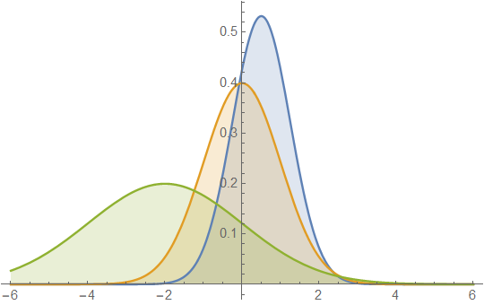
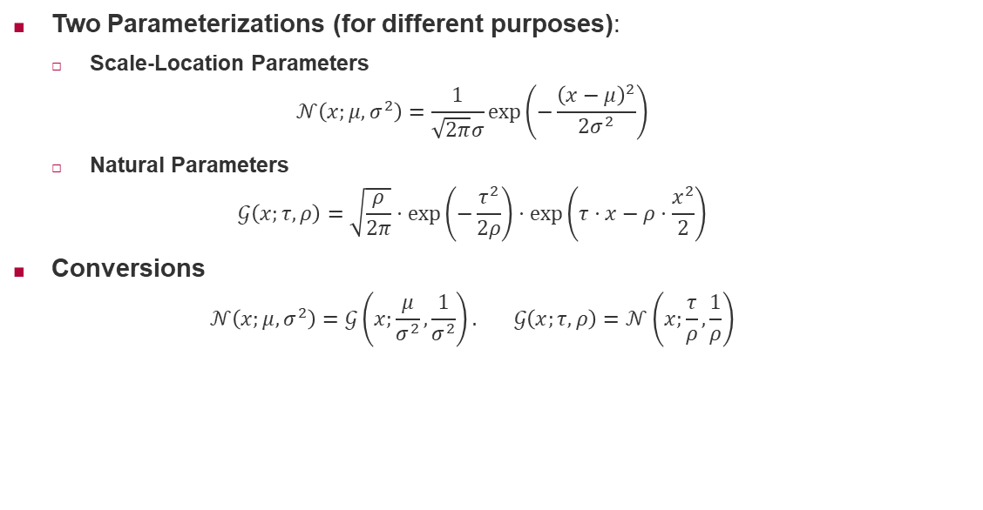
Recap: Normal Distribution: Representations
Two Parameterizations (for different purposes):
Scale-Location Parameters
$$𝒩\left(x;μ,σ^{2}\right)=\frac{1}{\sqrt{2π}σ}\exp\left(−\frac{{\left(x−μ\right)}^{2}}{2σ^{2}}\right)$$
Natural Parameters
$$𝒢\left(x;τ,ρ\right)=\sqrt{\frac{ρ}{2π}}⋅\exp\left(−\frac{τ^{2}}{2ρ}\right)⋅\exp\left(τ⋅x−ρ⋅\frac{x^{2}}{2}\right)$$
Conversions
$$𝒩\left(x;μ,σ^{2}\right)=𝒢\left(x;\frac{μ}{σ^{2}},\frac{1}{σ^{2}}\right). 𝒢\left(x;τ,ρ\right)=𝒩\left(x;\frac{τ}{ρ},\frac{1}{ρ}\right)$$
Two divisions only!

Slide 46
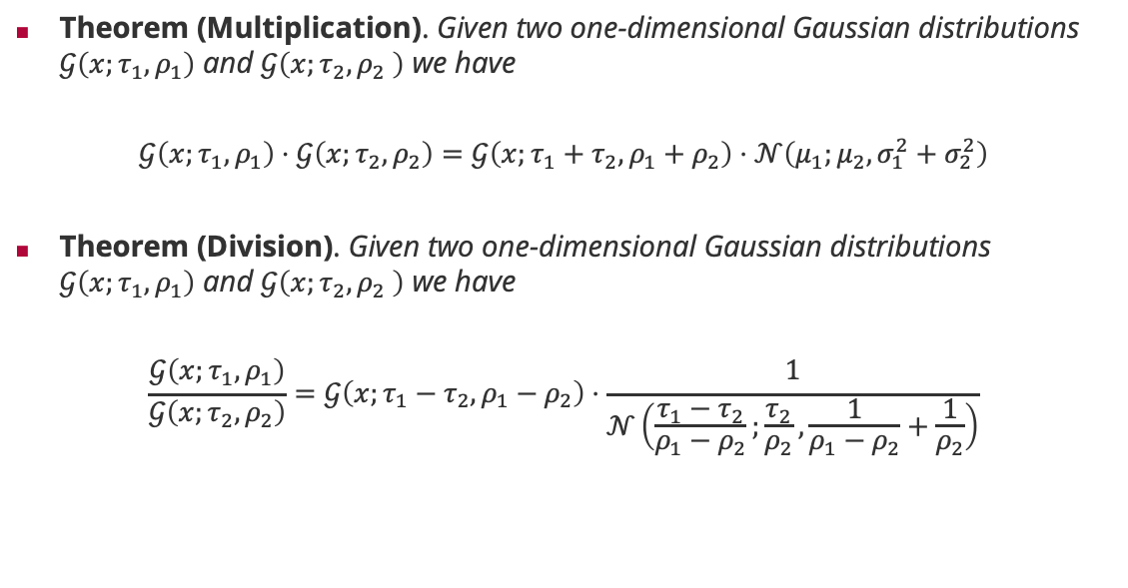
Recap: Normal Distributions and the Product Rule
Theorem (Multiplication). Given two one-dimensional Gaussian distributions $𝒢\left(x;τ_{1},ρ_{1}\right)$ and $𝒢\left(x;τ_{2},ρ_{2} \right)$ we have
$$𝒢\left(x;τ_{1},ρ_{1}\right)⋅𝒢\left(x;τ_{2},ρ_{2}\right)=𝒢\left(x;τ_{1}+τ_{2},ρ_{1}+ρ_{2}\right)⋅𝒩\left(μ_{1};μ_{2},σ_{1}^{2}+σ_{2}^{2}\right)$$
Theorem (Division). Given two one-dimensional Gaussian distributions $𝒢\left(x;τ_{1},ρ_{1}\right)$ and $𝒢\left(x;τ_{2},ρ_{2} \right)$ we have
$$\frac{𝒢\left(x;τ_{1},ρ_{1}\right)}{𝒢\left(x;τ_{2},ρ_{2}\right)}=𝒢\left(x;τ_{1}−τ_{2},ρ_{1}−ρ_{2}\right)⋅\frac{1}{𝒩\left(\frac{τ_{1}−τ_{2}}{ρ_{1}−ρ_{2}};\frac{τ_{2}}{ρ_{2}},\frac{1}{ρ_{1}−ρ_{2}}+\frac{1}{ρ_{2}}\right)}$$
Gaussian density
Additive updates!
Gaussian density
Subtractive updates!

Slide 47
Normal Distribution x Normal Distribution = ??
Let‘s collect key facts:
Conjugacy can be extremely important
Likelihood and Prior have to be such that Prior & Posterior are of same type
This particularly works for Normal Distributions
Normal Distributions can also be represented via Natural Parameters
For multiplication of densities natural parameters just have to be added

Slide 48
Multiplication of Normal Distributions
Approach: Multiply two Normal Distributions N1, N2 (scale parameters)
??
??
??

Slide 49
Multiplication of Normal Distributions
Approach: Multiply two Normal Distributions N1, N2 (scale parameters)
Translate them into Representation G1, G2 (natural parameters)
Multiply the Gaussians efficiently using the Multiplication Theorem
Obtain a Gaussian G3 and the normalization factor
And then ??

Slide 50
Multiplication of Normal Distributions
Approach: Multiply two Normal Distributions N1, N2 (scale parameters)
Translate them into Representation G1, G2 (natural parameters)
Multiply the Gaussians efficiently using the Multiplication Theorem
Obtain a Gaussian G3 and the normalization factor
Translate back the Gaussian G3 into a Normal Distribution N3
i.e., obtain N3 = N1 x N2 in standard scale parameters!
Task: Reproduce the formula for the Normal Posterior, see Unit 2, slide 9

Slide 51
Multiplication of Normal Distributions (Unit 2, slide 9)
Consider:
Translate N to G:

Slide 52
Multiplication of Normal Distributions (Unit 2, slide 9)
Consider:
Translate N to G:

Slide 53
Multiplication of Normal Distributions (Unit 2, slide 9)
Consider:
Translate N to G:
Multiplication Theorem:

Slide 54
Multiplication of Normal Distributions (Unit 2, slide 9)
Consider:
Translate N to G:
Multiplication Theorem:
Translate G back to N:

Slide 55
Multiplication of Normal Distributions (Unit 2, slide 9)
Consider:
Translate N to G:
Multiplication Theorem:
Translate G back to N:
Obtain final Formula:

Slide 56
Multiplication of Normal Distributions (Unit 2, slide 9)
Consider:
Translate N to G:
Multiplication Theorem:
Translate G back to N:
Obtain final Formula:

Slide 57
Overview
Course Setup
Recap: Probabilities and Distributions (Unit 1)
Recap: Main Concepts of Unit 2
Example: Bayesian Inference
Example: Multiplication of Normal Distributions
Example: Decision-Making
Hints for Exercise 1 (to be handed in Monday May 5)

Slide 58
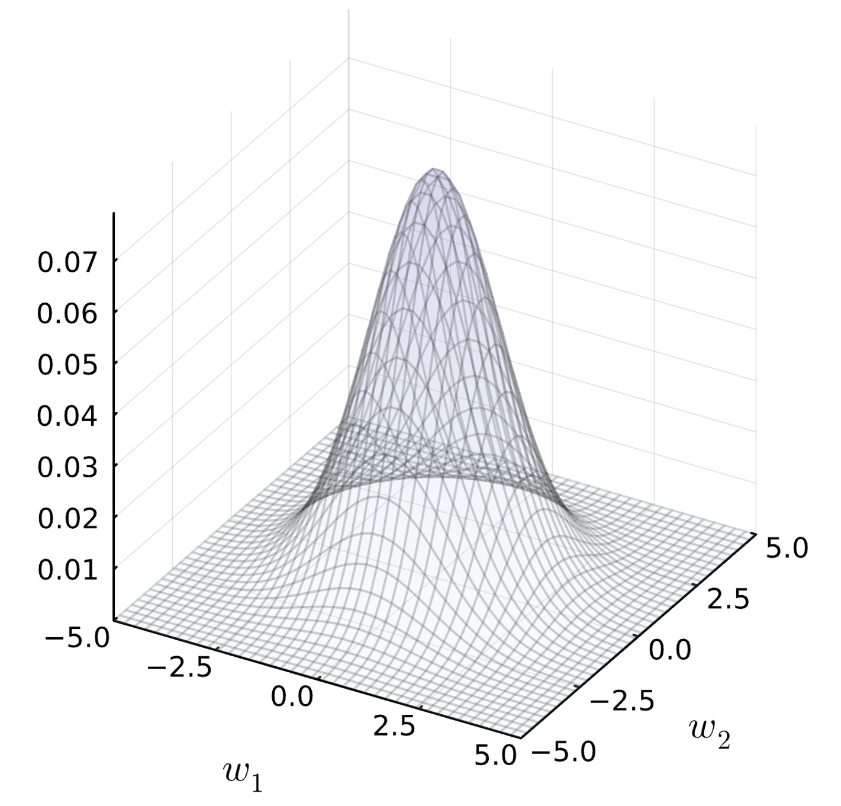
Data and Assumed Regression Model (Unit 2, slide 4)
Training Data: Prior for Combinations of Weights:
Assumed Regression Model (with 2 feature weights):

Slide 59
Likelihood (Unit 2, slide 4)
Likelihood (of observed Data under the assumed Model for certain weights):

Slide 60
Likelihood (Unit 2, slide 4)
Likelihood (of observed Data under the assumed Model for certain weights):

Slide 61
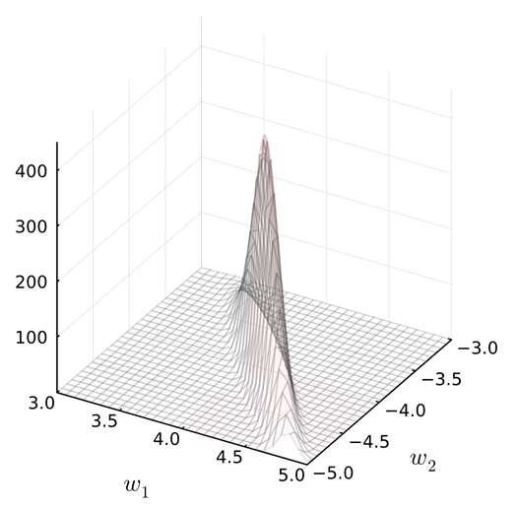
Likelihood (Unit 2, slide 4)
Likelihood (of observed Data under the assumed Model for certain weights):

Slide 62
Posterior (Unit 2, slide 5)
Posterior Distribution (of weights based on Data and Prior):

Slide 63
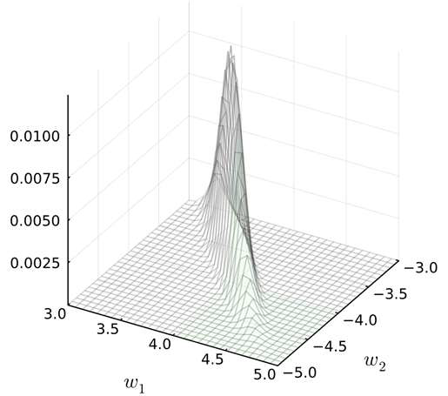
Posterior (Unit 2, slide 5)
Posterior Distribution (of weights based on Data and Prior):

Slide 64
Predictive Distribution (Unit 2, slide 5)
Predictive Distribution (based on Assumed Model, posterior-weighted):

Slide 65
Predictive Distribution (Unit 2, slide 5)
Predictive Distribution (based on Assumed Model, posterior-weighted):

Slide 66
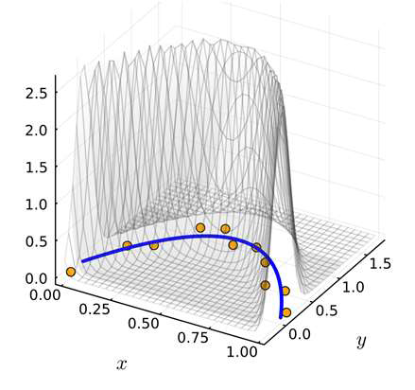
Predictive Distribution (Unit 2, slide 5)
Predictive Distribution (based on Assumed Model, posterior-weighted):

Slide 67
Decision Making: Min Expected Loss (Unit 2, slide 19-21)
What is the Best Action a (Supply) to meet uncertain Demand y?
Input (Temp.): Pred. Output (Demand):
Loss: Ideas?

Slide 68
Decision Making: Min Expected Loss (Unit 2, slide 19-21)
What is the Best Action a (Supply) to meet uncertain Demand y?
Input (Temp.): Pred. Output (Demand):
Loss: angry customers & workers
not enough to do & wasted hours
Expected Loss:

Slide 69
Decision Making: Min Expected Loss (Unit 2, slide 19-21)
What is the Best Action a (Supply) to meet uncertain Demand y?
Input (Temp.): Pred. Output (Demand):
Loss: angry customers & workers
not enough to do & wasted hours
Expected Loss:
Cost of Best Decision:
Cost of Decision a=E(y):

Slide 70
Overview
Course Setup
Recap: Probabilities and Distributions (Unit 1)
Recap: Main Concepts of Unit 2
Example: Bayesian Inference
Example: Multiplication of Normal Distributions
Example: Decision-Making
Hints for Exercise 1 (to be handed in Monday May 5)

Slide 71
Exercise 1 (until May 5)
Part I: Discrete Uniform & Gaussians in Julia
Part II: Generic Distributions in Julia
Part III: Show Identities for Representations of Gaussians
and verify the Multiplication Theorem ☺
Part IV: Conjugacy of the Beta Distribution

Slide 72
Summary
Recap I: Recap Expectation and Variance of Random Variables
Recap II: Beta Distribution (Conjugacy, Discrete Likelihood)
Recap III: Normal Distribution (Conjugacy, Continuous Likelihood)
Recap IV: Decision-Making based on derived Posteria

Slide 73
See you next Week!

